Slide 1
DATA PREPROCESSING
Data preprocessing is the process of transforming raw data into an understandable format.
Data preprocessing can refer to manipulation or dropping of data before it is used in order to ensure or enhance performance, and is an important step in the data mining process.

Slide 2
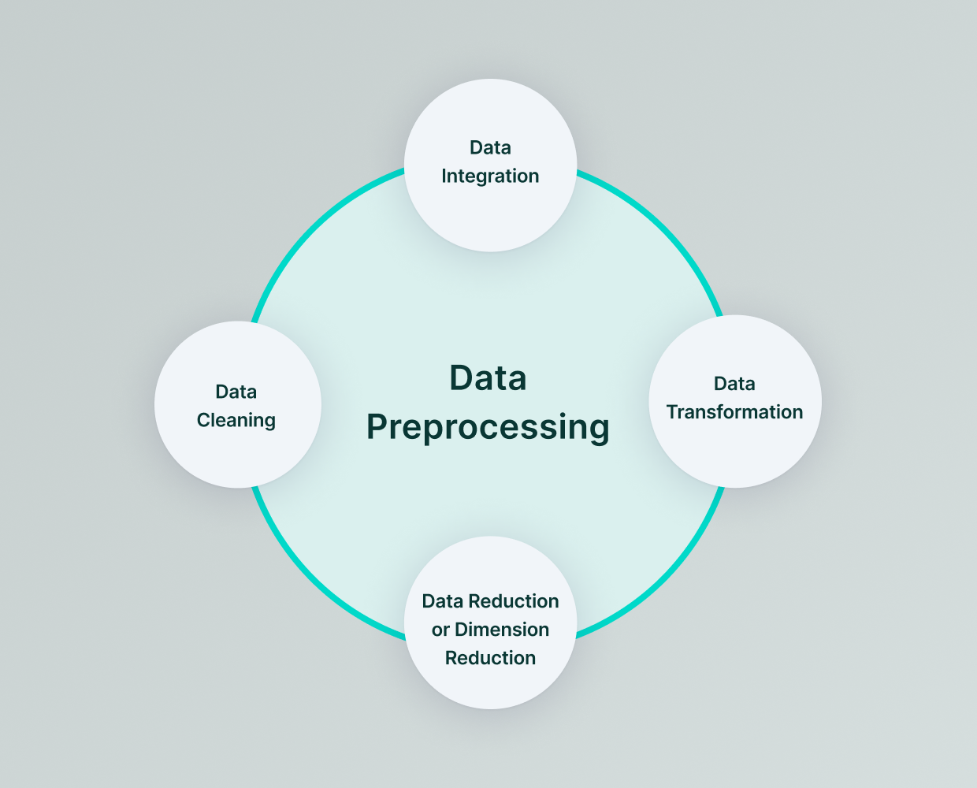
DATA PREPROCESSING

Slide 3
Data Preprocessing Tools
IMPORTING LIBRARIES
import numpy as np
import pandas as pd
import matplotlib.pyplot as plt
import seaborn as sns
IMPORTING DATA SET
df = pd.read_csv(“df.csv”)

Slide 4
TAKING CARE OF MISSING VALUES
from sklearn.impute import SimpleImputer
imputer = SimpleImputer(missing_values=np.nan, strategy='mean’)
imputer.fit(X[:, 1:3])
X[:, 1:3] = imputer.transform(X[:, 1:3])

Slide 5
Encoding categorical data
Encoding the Independent Variable¶
from sklearn.compose import ColumnTransformer from
sklearn.preprocessing import OneHotEncoder
ct = ColumnTransformer(transformers=[('encoder', OneHotEncoder(), [0])], remainder='passthrough’)
X = np.array(ct.fit_transform(X))
Encoding the Dependent Variable
from sklearn.preprocessing
import LabelEncoder le = LabelEncoder()
y = le.fit_transform(y)

Slide 6
Splitting the dataset into the Training set and Test set
from sklearn.model_selection import train_test_split
X_train, X_test, y_train, y_test = train_test_split(X, y, test_size = 0.2, random_state = 1)
Feature Scaling
from sklearn.preprocessing import StandardScaler
sc = StandardScaler()
X_train[:, 3:] = sc.fit_transform(X_train[:, 3:])
X_test[:, 3:] = sc.transform(X_test[:, 3:])

